Slide 1
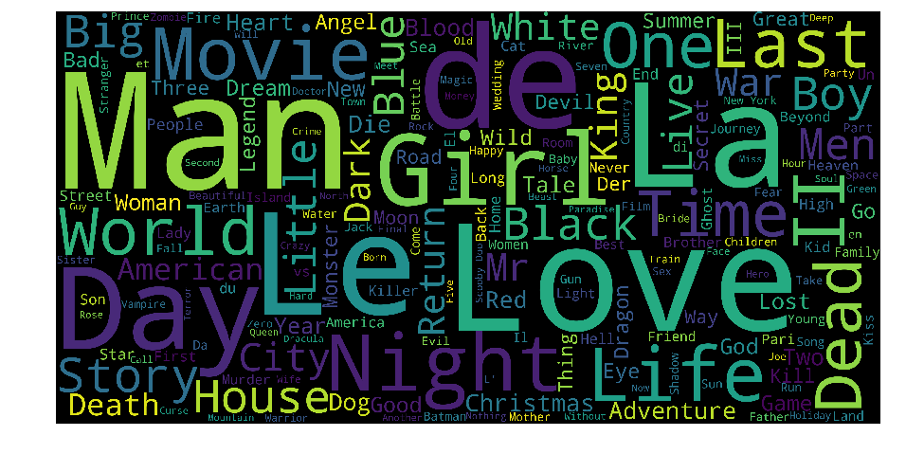
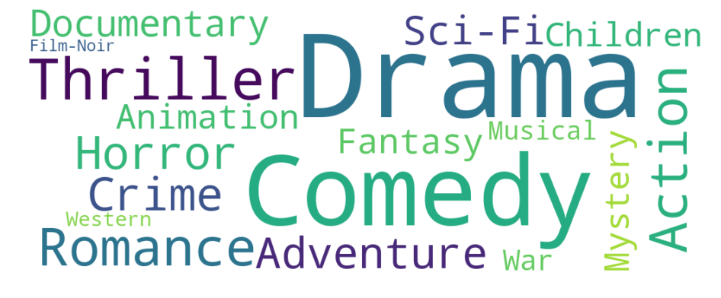
Fig 1. word cloud of movie title
Fig 2. word cloud of movie genres

Slide 2
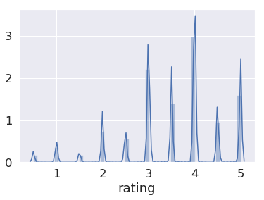
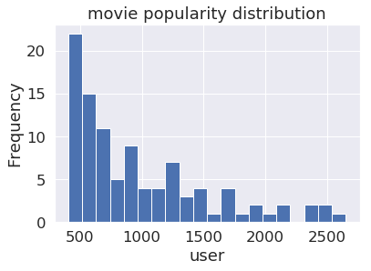
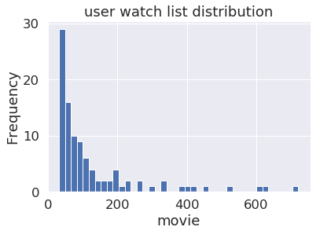
Fig 3. User rating distribution
Fig 4. Movies’ popularity
Fig 5. User watch history distribution

Slide 3
Fig 6: Uncover potential audiences

Slide 4
Fig 7: Recommend movies to the customer

Slide 5
Fig 8: Recommend movies to the customer

Slide 6
Fig 8: Recommend movies to the customer

Slide 7
Fig 9: Recommend movies to the customer

Slide 8
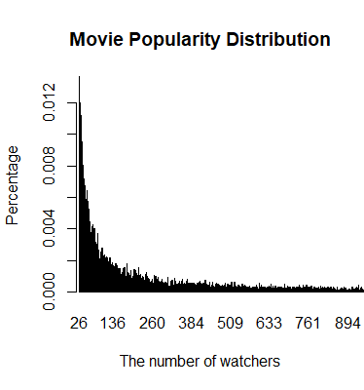
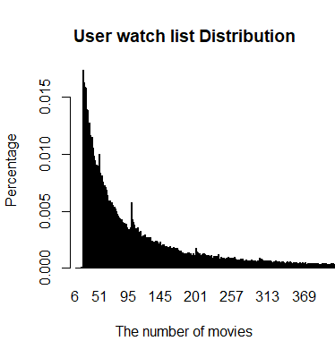
Fig 4. Movies’ popularity
Fig 5. User watch history distribution

